Slide 1

Book Shop Automation Software Software Requirements Specification
Indian Institute of Information Technology Ranchi
Guided By:- Dr. Jayadeep Pati
Presented By:-
Suraj Kumar (2019UGCS027R)
Nitish Kumar (2019UGCS023R )
Mani Shankar Choudhary (2019UGCS006R ) Abhishek Kumar Kushwaha (2019UGCS035R

Slide 2
Content
1 Introduction
1.1 Purpose
1.2 Scope
1.3 Definitions,Acronyms,and Abbreviations
1.4 References
2 overall Description
2.1 Product Perspective
2.2 product function
2.3 User characteristics
2.4 Constraints
2.5 Assumption and Dependencies
3 Specific Requirements
3.1 External Interfaces
3.2 Functions Requirements
3.3 Non-Functional Requirements
3.4 Design Constraints
3.5 Software system quantity Attributes

Slide 3
1.1 Purpose:- The purpose of this document is to give a detailed description of the requirements for the “Book Shop Automation Software” (BAS) software. It will illustrate the purpose and complete declaration for the development of system. 1.2 Scope :- In today’s world, there arises a need to get things done quickly and efficiently. Customers find it difficult at times to find a book from book shops close to them . At the same time, the book shop owner wouldn’t want to take a risk of losses due to stagnant stock.
1. Introduction

Slide 4
1.3 Definitions , Acronyms , and Abbreviations • BAS Book Shop Automation Software • SRS Software Requirements Specifications • ISBN is a unique 13 digit code for each book. Contains information related to Title, Publisher and Group etc. 1.4 References • IEEE standard template for IEEE standard • Fundamentals of Software Engineering by R . Mall

Slide 5
2.1 Product Perspective :- The BAS is an independently functioning system that automates manual tasks in a Book Shop like answering customer queries, billing, making sales statistics, planning for further orders etc. 2.2 product function The book-shop automation system provides the following facilities and services: 2.2.1 Query for books: 2.2.2 Request for book: 2.2.3 Update stock and inventory: 2.2.4 View request 2.2.5 Generate sales receipt: 2.2.6 Generate sales statistics: 2.2.7 print the list of books to be bought depending on the inventory level:
2.overall Description

Slide 6
2.3 User characteristics
Main class has the access to information as it contains aggregations of many class objects and is the most privileged in the sense of access. Cart is used very frequently in conjunction with Sales Clerk to buy books and print receipts.
2.3.1 Book
2.3.2 Employee
2.3.3 Sales Day
2.3.4 Not In Collection
2.3.5 Cart
2.3.6 Main
2.3.7 Other auxiliary classes :

Slide 7
2.4 Constraints
As the BAS needs to handle large number of books, that may lead to lagging of the system to handle data from database. A linear time algorithm may itself lose efficiency in such cases. Logarithmic time algorithms can be used ,but they will compromise on the memory used.
2.5 Assumption and Dependencies
We have assumed that the computer used in the book shop is perfectly working and has a perfectly working Java runtime environment and JVM installed. As the software is built using Java, it is safely assumed that appropriate software is installed.

Slide 8
3 Specific Requirements
3.1 External Interfaces
3.1.1 User interfaces :-
User interface is used to provide communication between users and system. When users look at the interface, they should understand which pane is used for which purpose. Each task of an interface should be specified clearly and users should use them correctly. For example, when users press to any button on interface, they should know which operations are done by pressing this button. The user interface should be easy to learn

Slide 9
3.1.2 Hardware Interfaces The hardware interface for the user would be any PC having a configuration of P-IV and above 2GB HDD for loading any OS so that BAS could interact with the system without any problem. The main interface would be monitor, keyboard and mouse.
3.1.3 Software Interfaces
Book Shop Automation Software will use database for storing and management of records. So an access to the database management system is request.
3.1.4 Communications Interfaces
For communications sockets on TCP shall be used. A client program creates a socket on its end of the communication and attempts to connect that socket to a server.

Slide 10
3.2 Functions Requirements
3.2.1 Check for availability of book:-
When customer selects this option he is required to enter book title or the author name of book. After making the search the system should output the details of all the books based on the details given.
3.2.2 View request:-
Once the manager selects this option, the system displays the current demand for different books.
3.2.3 Purchase Book:-
Once the customer selects this option the system will ask to enter the ISBN no. of books sold.
3.2.4 Update stock:-
Once the employee selects this option , he would be asked to enter the list of new book name.
3.2.5 Generate Sales Statistics:-
Once the manager selects this option, he will be informed about exact business done over any period of time. It also calculates inventory level required for various books.

Slide 11
3.3 Non-Functional Requirements
3.3.1 Performance Requirements
3.3.2 Safety Requirements
3.3.3 Security Requirements
3.3.4 Software quality
3.3.5 Business Rules

Slide 12
3.4 Design Constraints
3.4.1 Menu driven:-
The system is based on menu driven interfaces. Menu selection will be done by using the mouse and the key board keys.
3.4.2 Confirmation message:-
Confirmation messages on taken actions, input acceptance and error conditions will be displayed after each input.
3.4.3 Error Detection:-
Error messages will be displayed at the time of detection of input errors and the system errors.

Slide 13
3.5 Software system quantity Attributes
The software must include user authentication for all types of operation besides operation by the customer. Different classes of employees have different accessibility privileges and this must be strictly upheld for the data to remain safe.

Slide 14
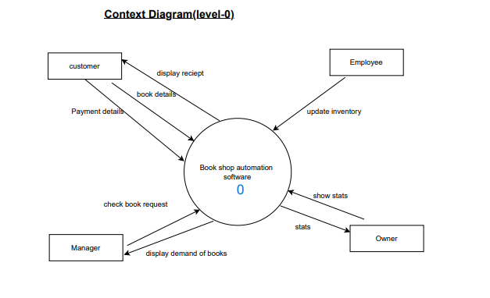

Slide 15
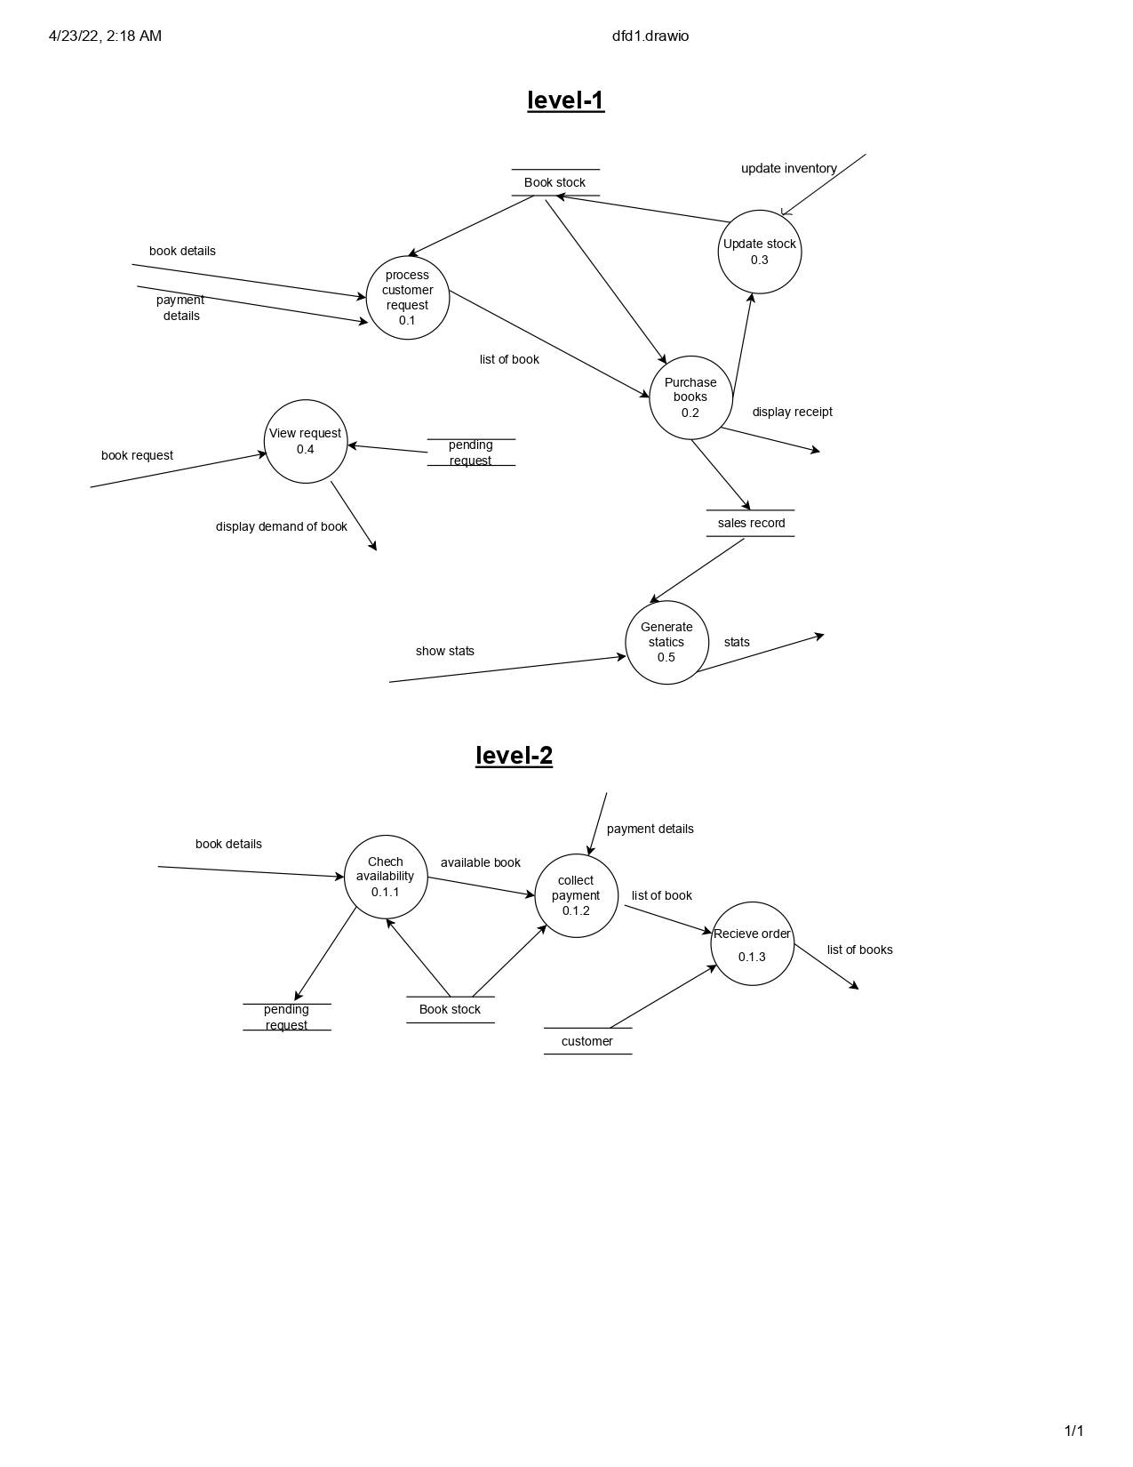

Slide 16
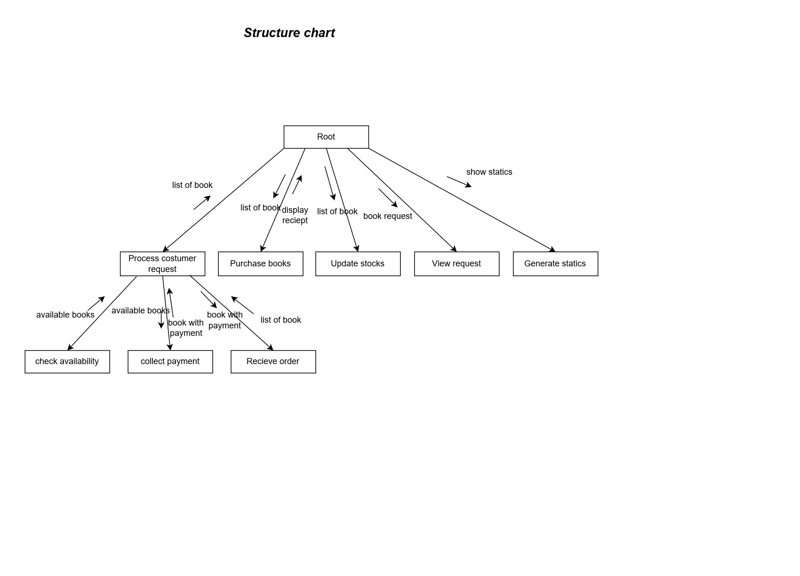

Slide 17
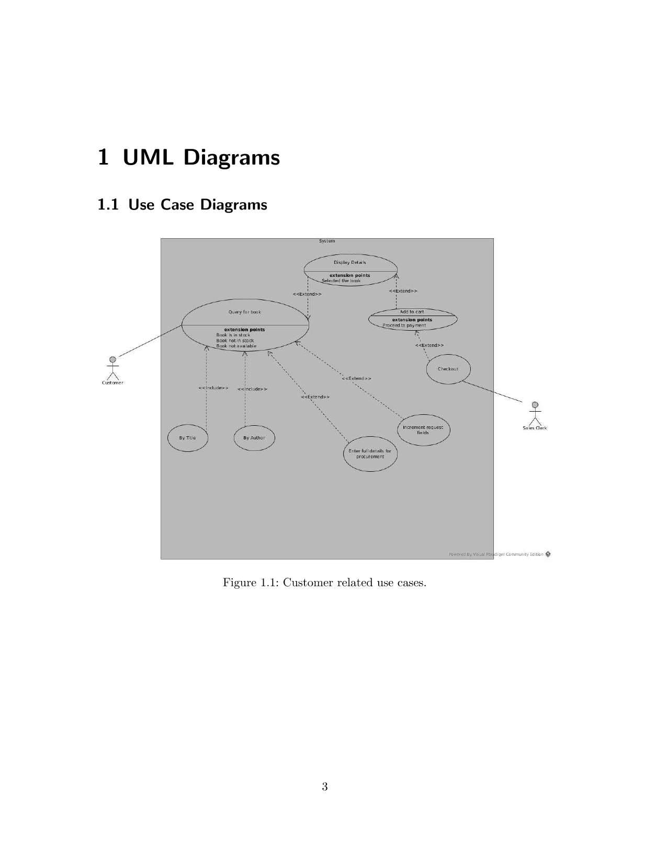
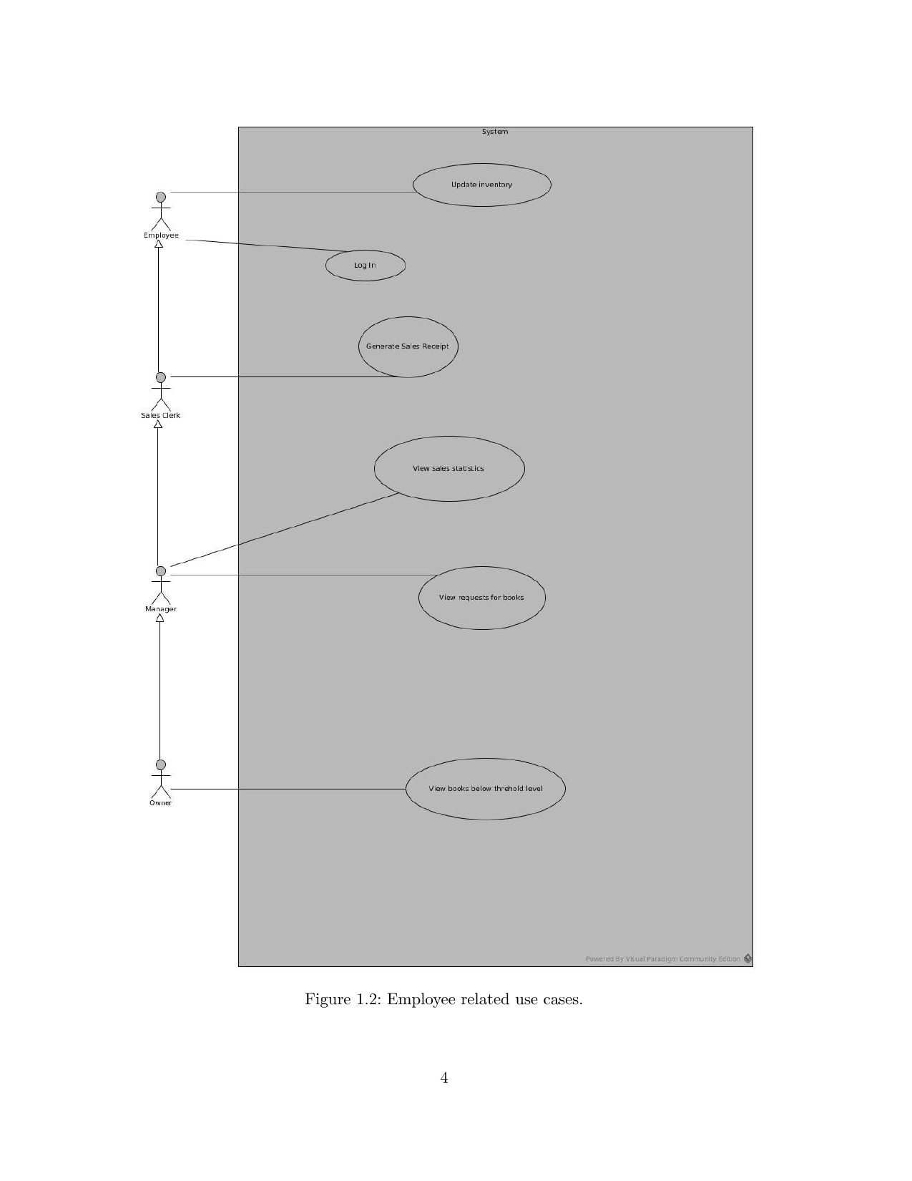

Slide 18
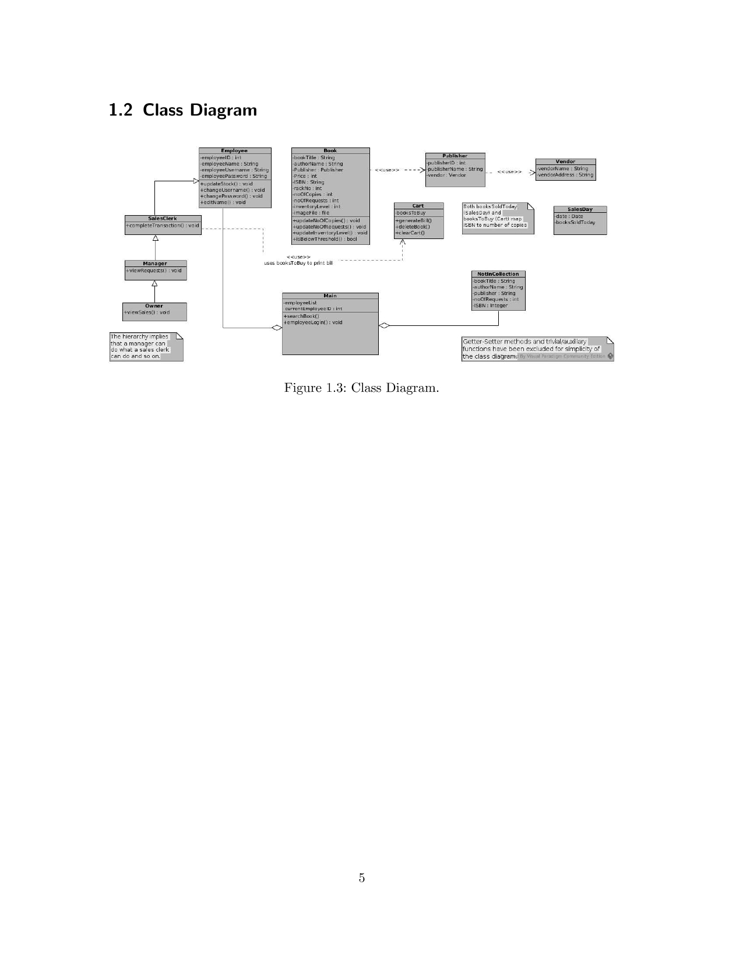
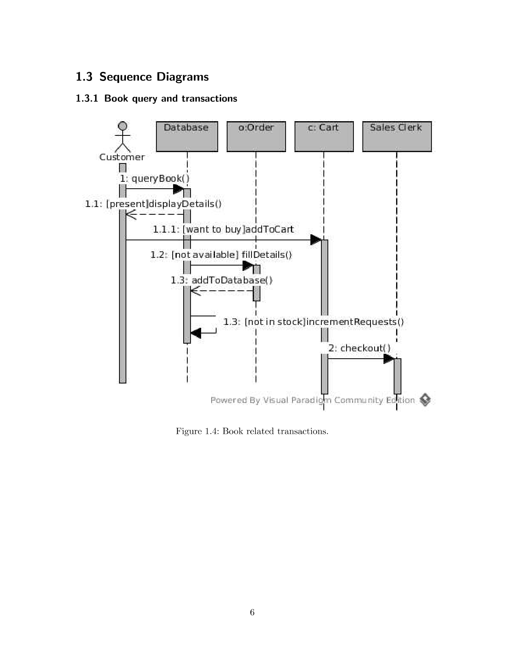

Slide 19
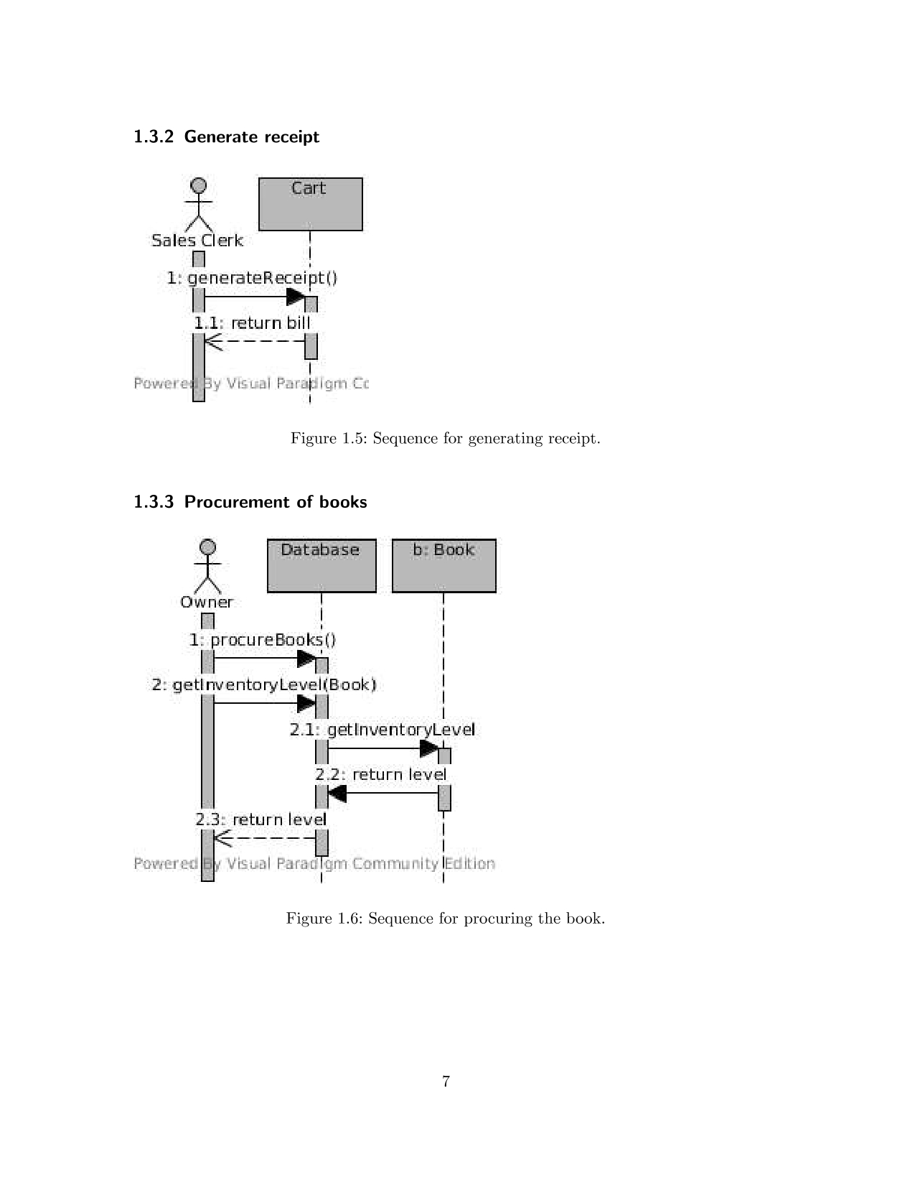
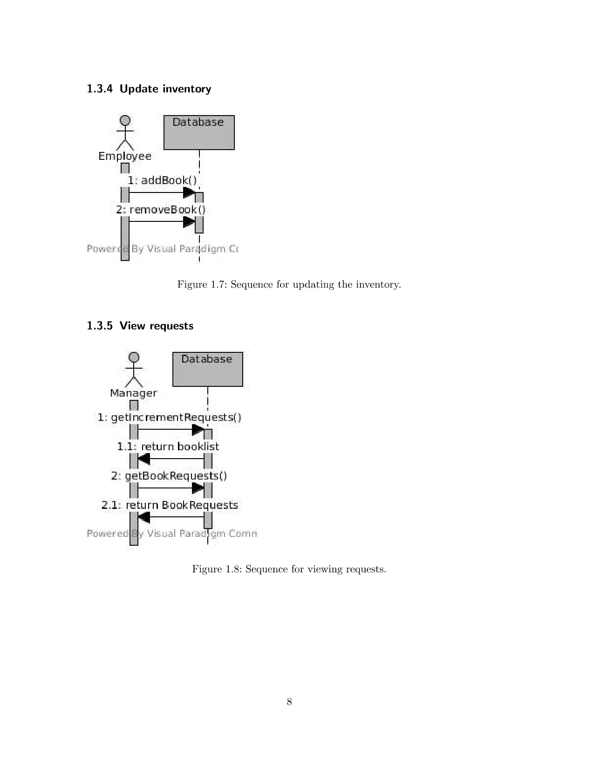

Slide 20
Thanks

